Slide 1


Proof Of Concept
UI Automation
Framework: Python + Selenium + PyTest
Use Case: Order / Service / Cancel
@ Chitranjan Kumar

Slide 2




Demo
Recording

Slide 3
Plus
☑ Install/Setup/Execution – Ease of Use
☑ Auto wait – Time saving
☑ Ease of reporting / Logging
☑ Integration with slack/Jenkins
☑ Support for all browsers (incl. Headless)
☑ Open Source / Huge support base

Slide 4
Challenges
☑ Nothing as of now, still needs more evaluation
Parallel execution to be tried.
☑ Learning curve of Python

Slide 5
Framework Design
Key Highlights:
- Easily portable
- Highly modularized
- Loosely coupled
- Auto Waiting
UI
Automation
Virtual Environment
Results
Pages
Locators
Tests
Html Report
Helpers
Global config file
Log file
Json reader
Logger
Selenium wrapper
config.ini
pytest.ini
ui-config.py
Google
Amazon
conftest.py
Junitreport.xml
Resources
Browser drivers
Test data(json files)

Slide 6
Future Enhancement
Tagging to group test cases(Example: @regression, @sanity etc)
Video recoding
Parallel execution for faster results
Integration with Selenium 4 (post release)

Slide 7
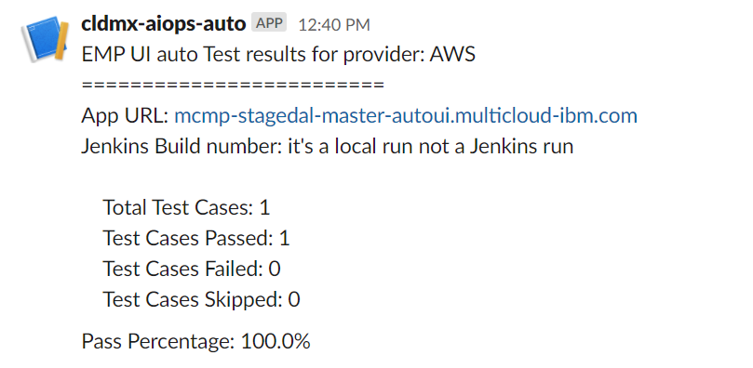
Slack report

Slide 8
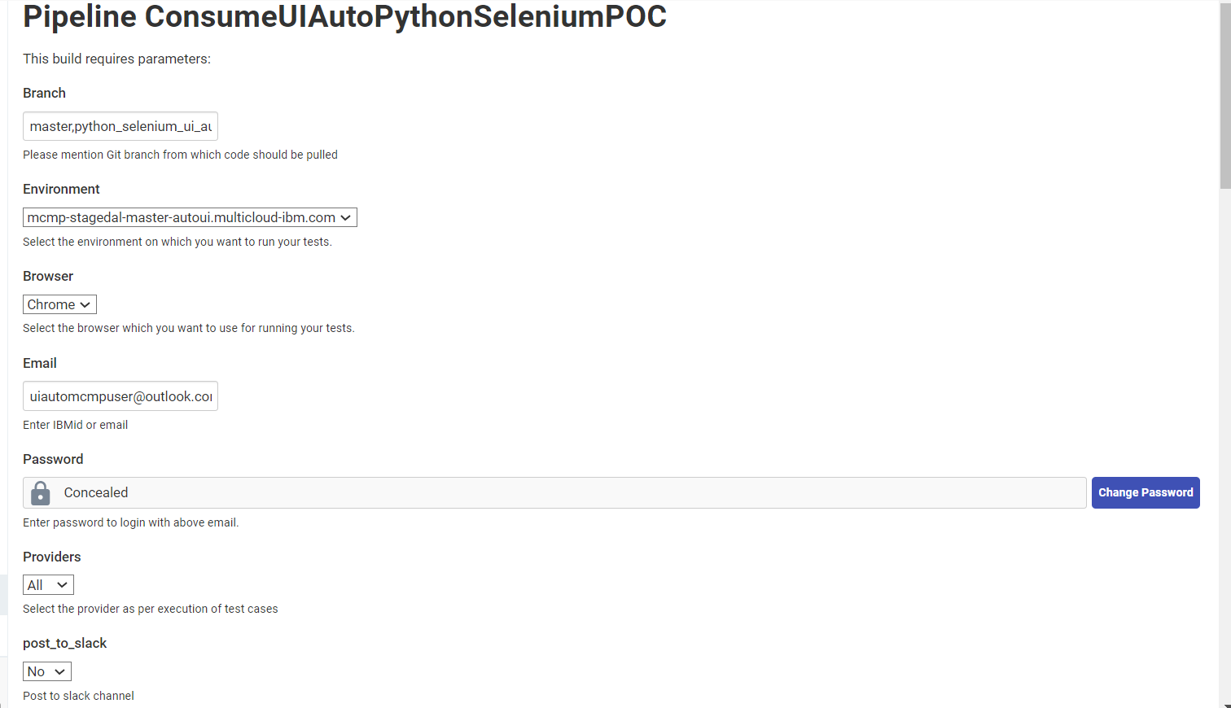
Jenkins job

Slide 9


Slide 10
Back-up

Slide 11
Plus
Install/Setup – Ease of Use
Page object design pattern
Auto waiting for the elements
Re-run the failed test cases
Modular scripts for better maintainability
Loosely coupled framework
Flexibility to use any kind of locators(CSS, path)
Detailed reports (Html Report, Allure and pytest html reporter)
Detailed logs for each steps of execution

Slide 12
PLUS
Quick generation of test script
Global run configurations
Capture screenshot for failed test cases
Support for multiple browser(Chrome, Firefox , Safari)
Support for Headless browser automation
Huge Documentation & Community Support
Integration with CI/CD(Jenkins)
Integration with slack

Slide 13
Checklist | Specification | Selenium With Python | Comments
Availability
 | Open source | ☑
User-friendly and Reliable
 | Quick & Easy to setup
 | Very stable and reliable
 | Fast to implement & debug
 | Easy syntax
Essential Quality
 | API mocking support |  | Not Tried, but should work
 | Supports multiple test libraries
 | Support for multiple browsers and platforms
 | Easy to keep using the latest versions of packages
 | Database support
 | Auto-waiting for elements
 | Screenshots
 | Reports capturing logs and har

Slide 14
Checklist | Specifications | Selenium With Python | Comments
Community Support
 | Active community and updates
Good to have
 | Parallel run
 | Retry mechanism for failed cases
Integration with other app
 | Jenkins
 | Post to Slack
 | Post to DI
 | Support of CI/CD, Docker or any modern platforms integration
POC Progress as per the scope defined
 | Completed
 | Inprogress

